Slide 1
Graphs

Slide 2
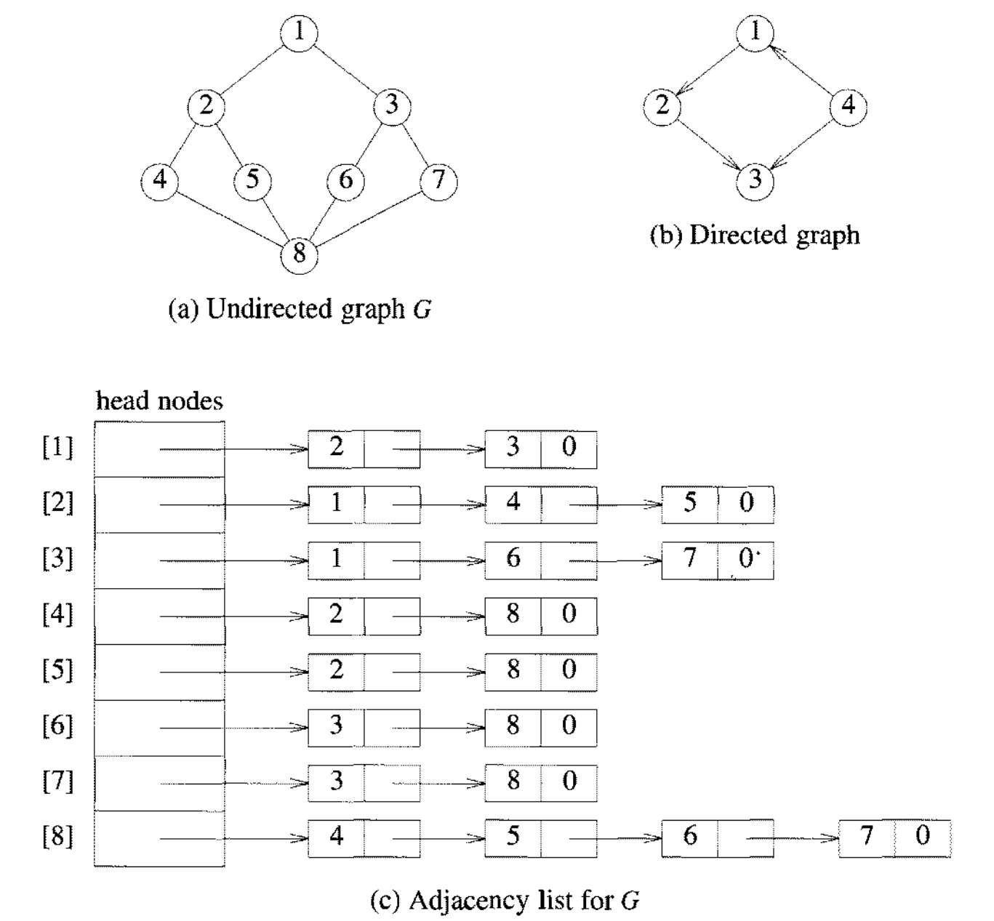

Slide 3
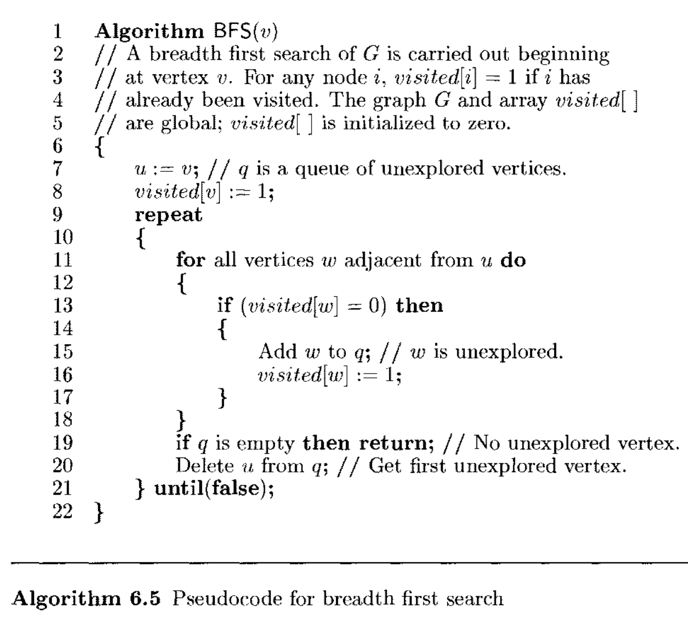

Slide 4
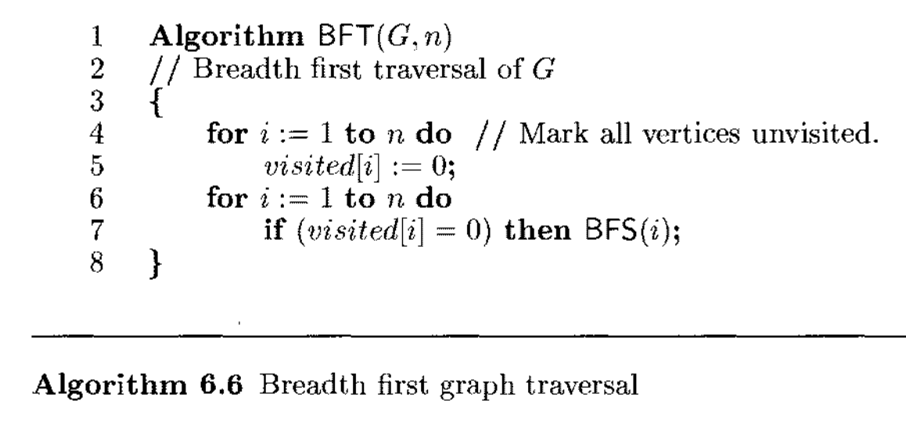

Slide 5
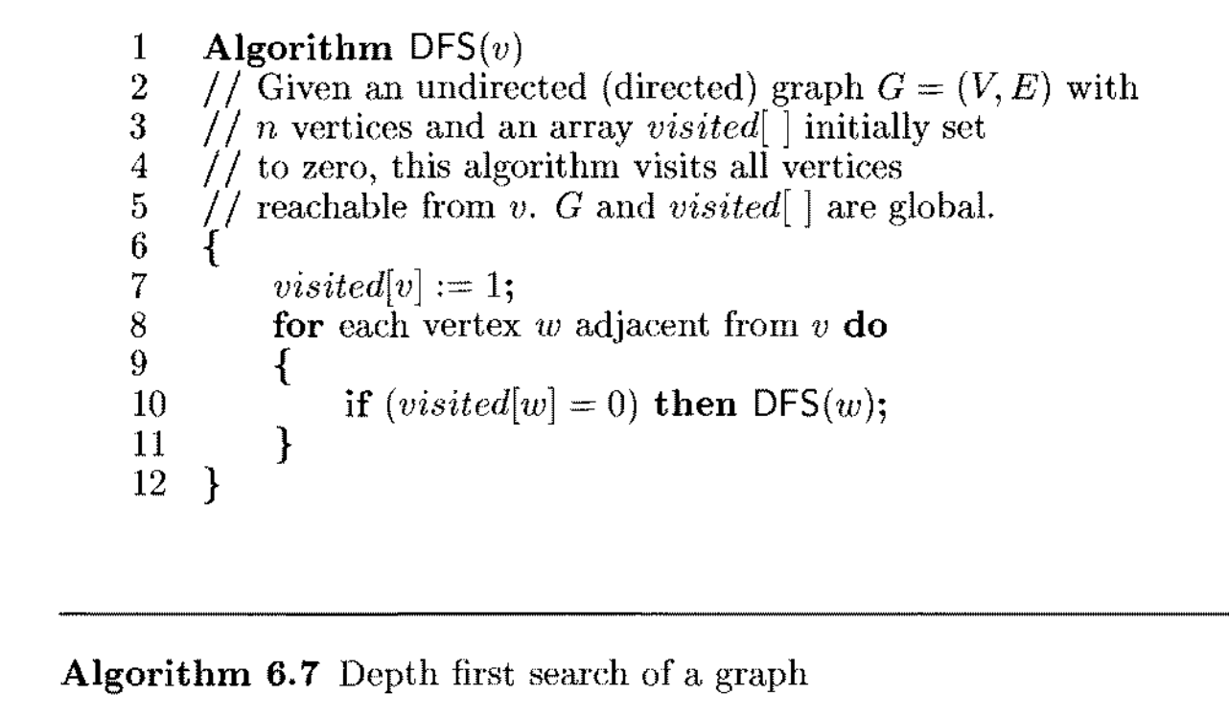

Slide 6

Biconnected Components and DFS

Slide 7
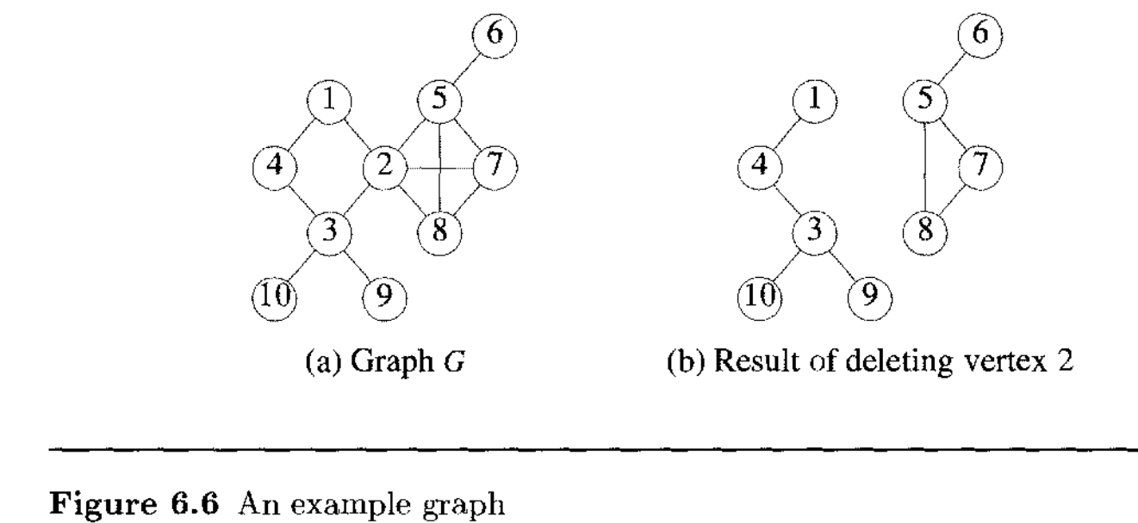

Slide 8
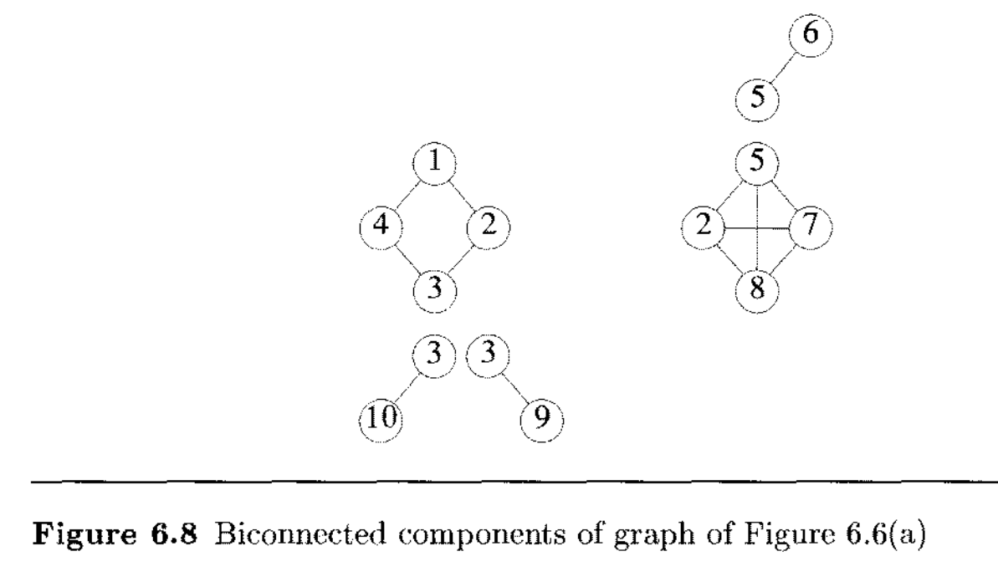

Slide 9
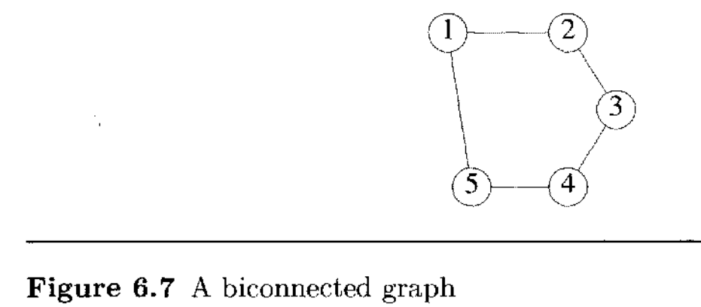

Slide 10

Biconnected Components and DFS

Slide 11
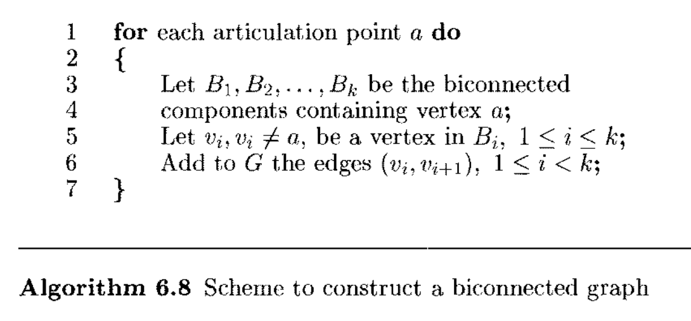
Biconnected Components and DFS

Slide 12

Biconnected Components and DFS

Slide 13
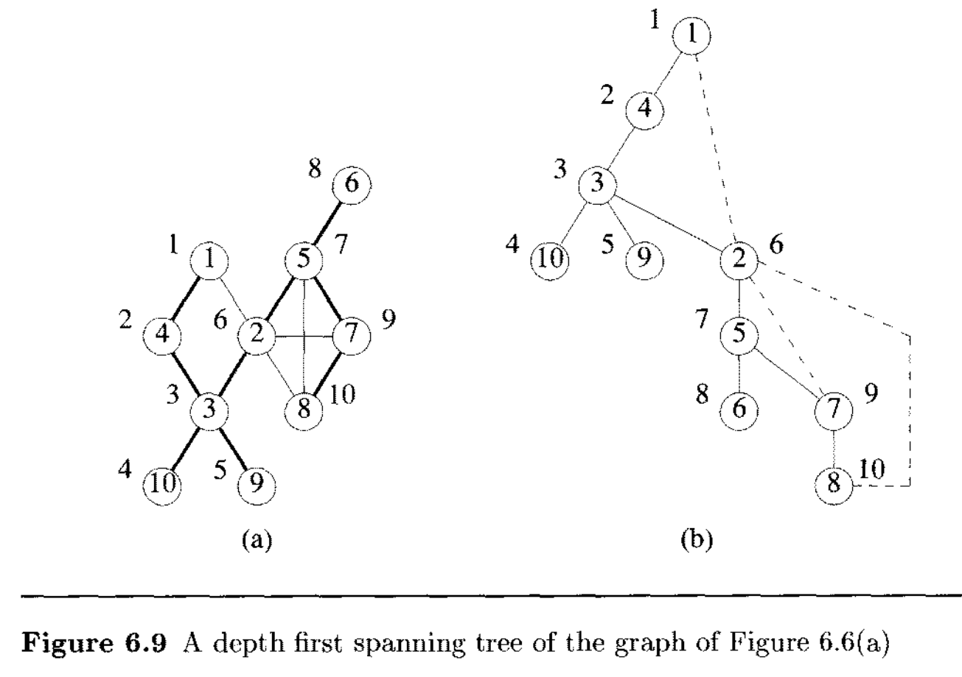

Slide 14


Biconnected Components and DFS

Slide 15
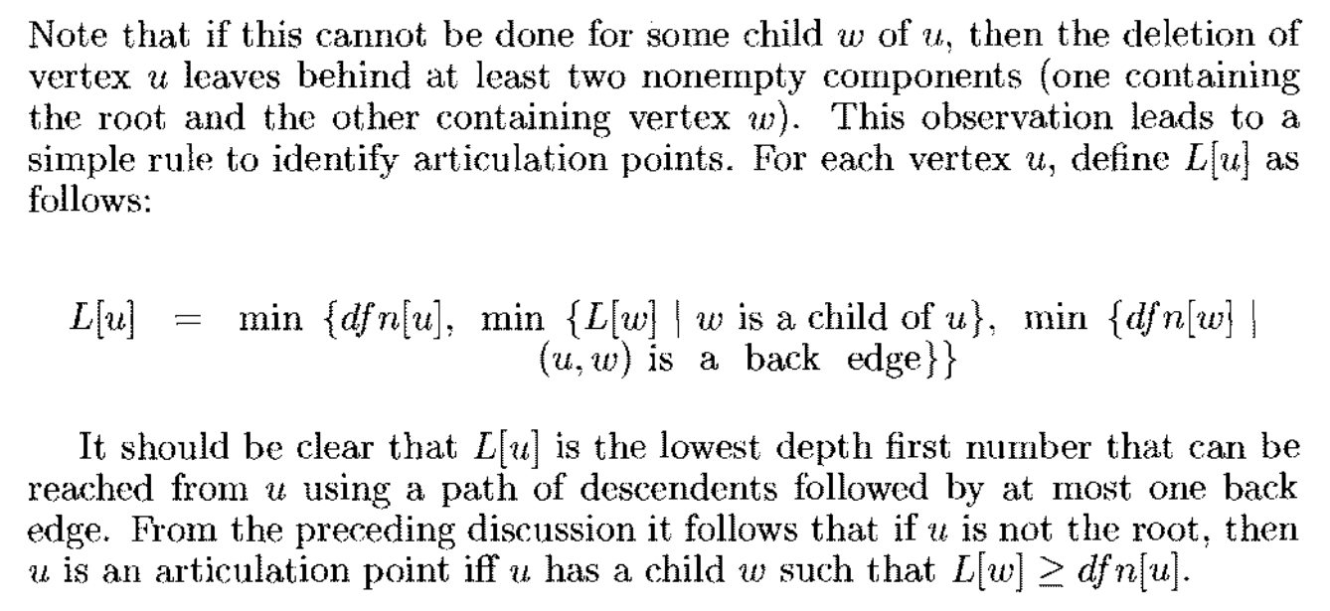
Biconnected Components and DFS

Slide 16

Biconnected Components and DFS

Slide 17
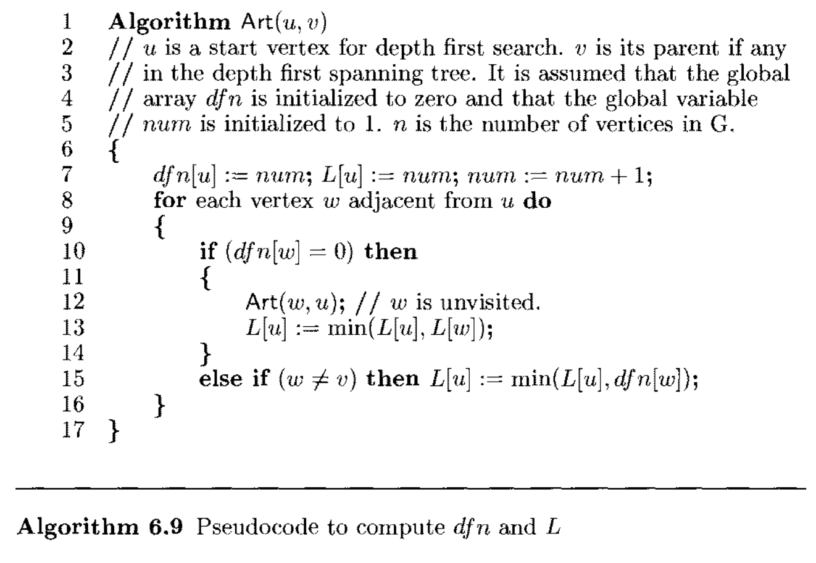

Slide 18


Slide 19
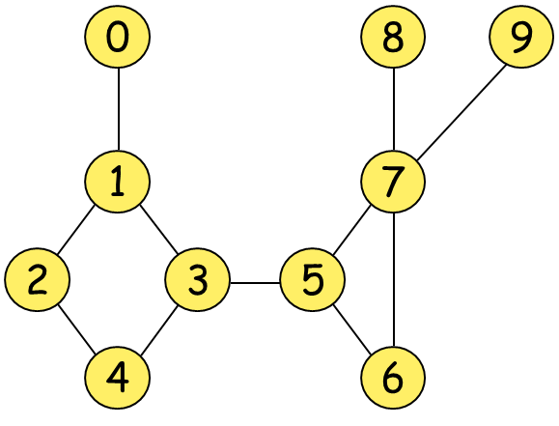

Slide 20
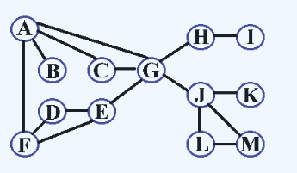

Slide 21
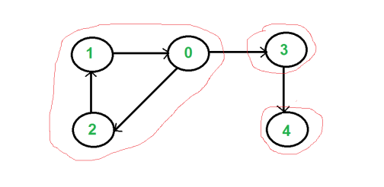
Strongly Connected Components
Given a directed graph 𝐺 = (𝑉, 𝐸), Strongly Connected Component is a maximal sub-graph such that there is a directed path between every pair of vertices.

Slide 22
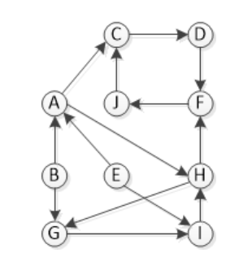

Slide 23
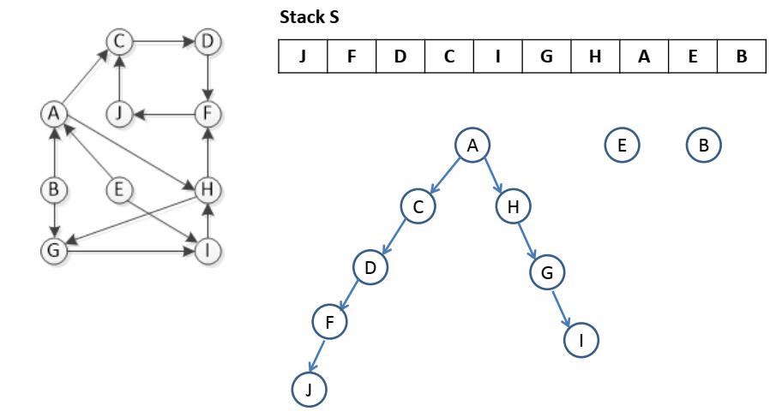

Slide 24
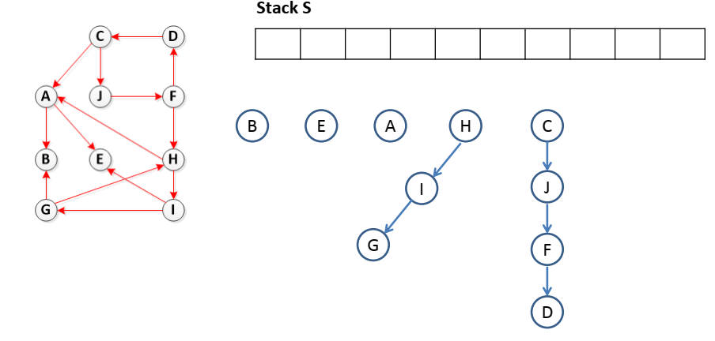

Slide 25
